Slide 1
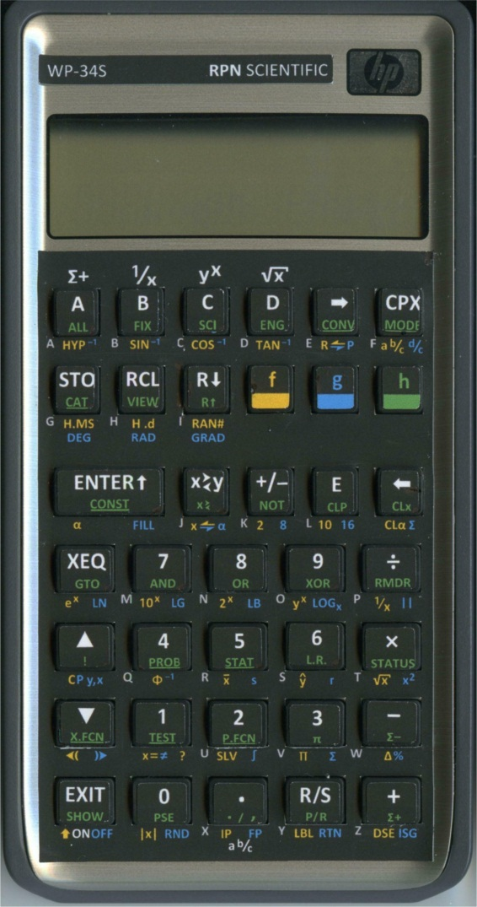
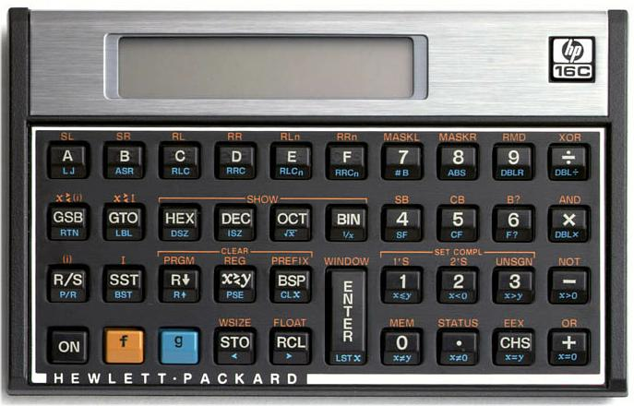
An HP16C / WP 34S Dictionary
Jake Schwartz

Slide 2
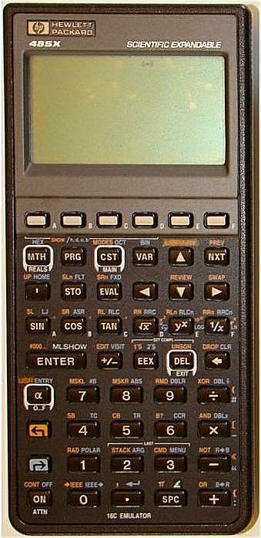
Restoring the 16C Functionality in 1993: The HP16C Emulator Library for the HP48

Slide 3
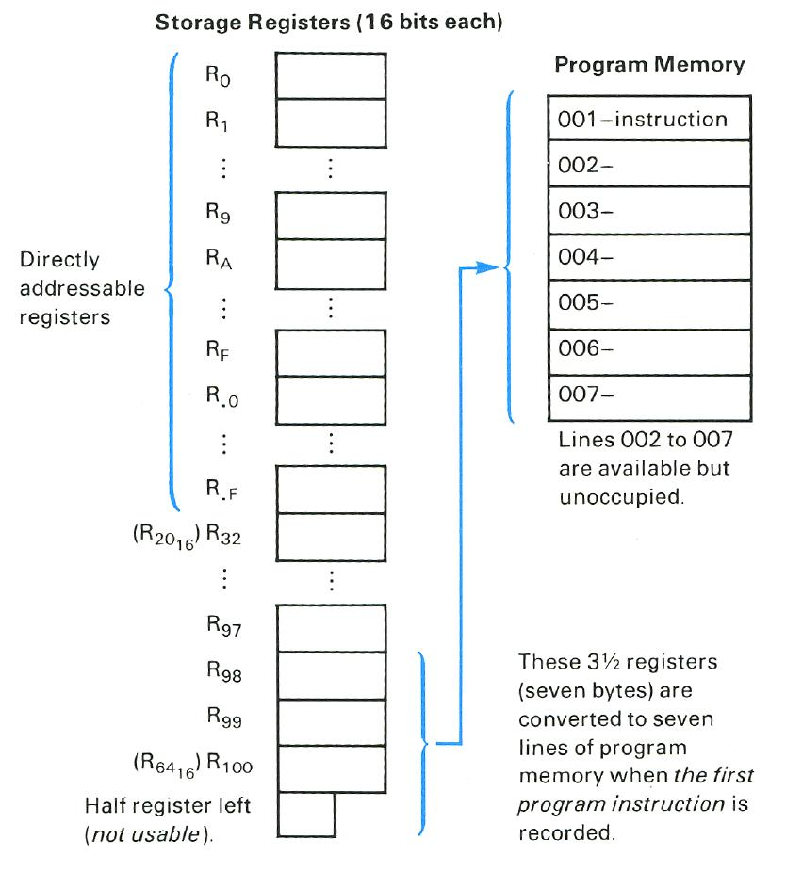
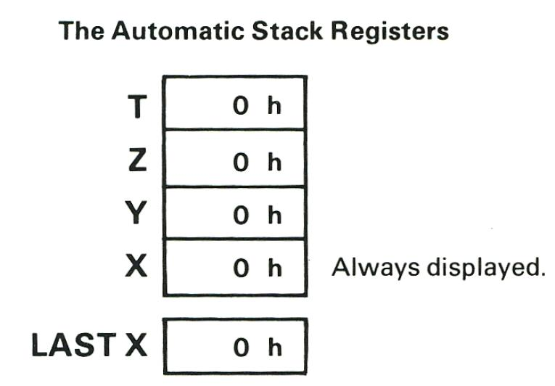
16C Memory Layout

Slide 4
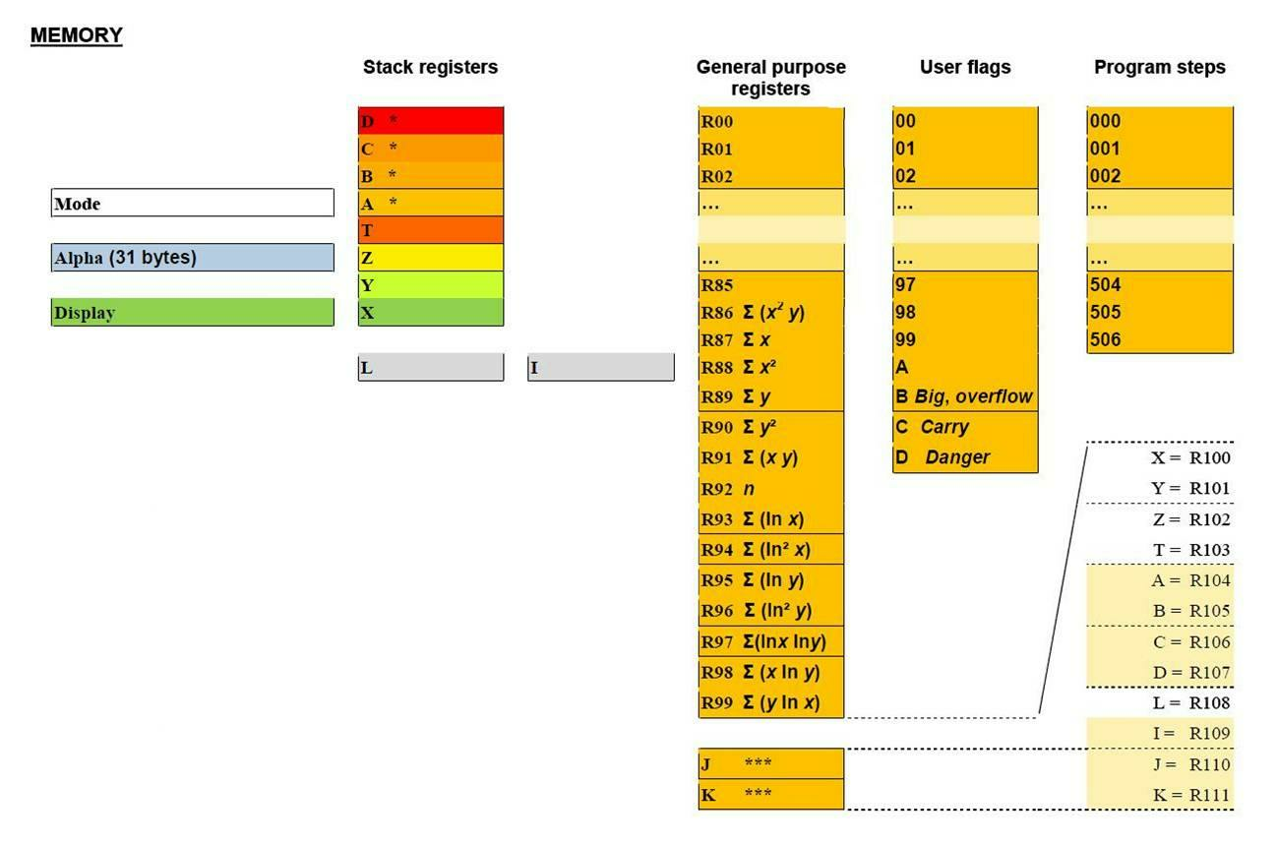
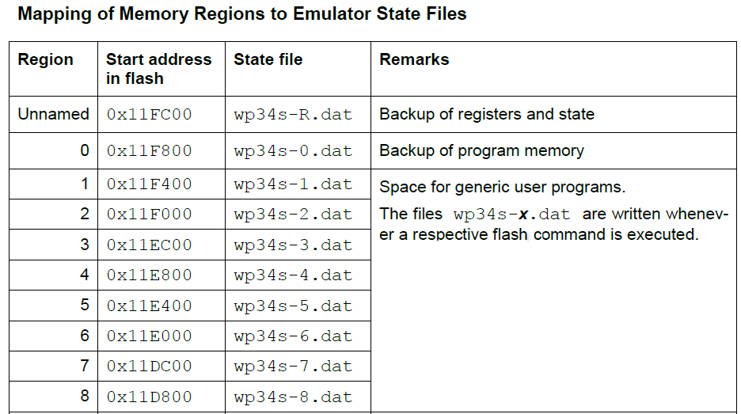
34S Memory Layout
(506 steps)

Slide 5
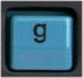
Stack and Display Manipulation
16C (4-level stack):
34S (4- or 8-level stack):
ENTER
Roll Down
Roll Up
X Exchange Y
Clear X
Last X
Switch to
Floating Point Mode
Leading 0’s On
Leading 0’s Off
n

Slide 6
Math Functionality
16C:
34S:
+, -, ×, ÷
Square Root
Reciprocal
Absolute Value
Remainder
Double Multiply
Double Divide
Double Remainder
Square
10ˣ, log, 2ˣ, log₂, yˣ

Slide 7
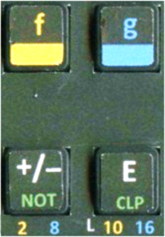
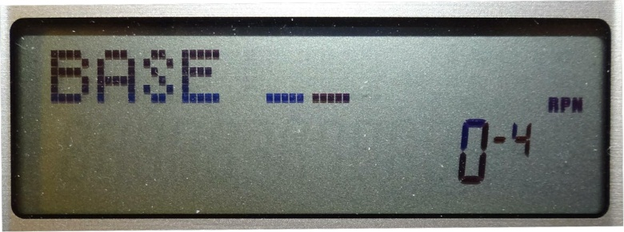
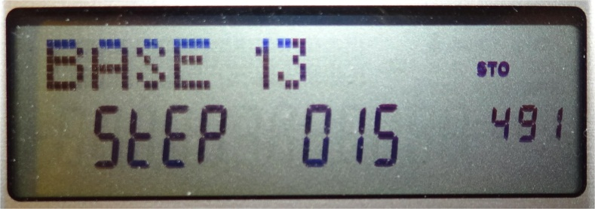
Base Conversions
16C:
Any base (2-16) via MODE menu:
34S:

Slide 8
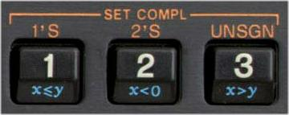
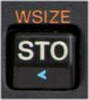
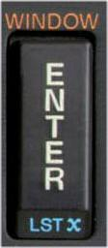
Complement Modes and Word Size
16C:
34S:
WSIZE
(1-64)
16C:
WINDOW 0-7
in 8-digit chunks
34S:
left-, right-shift
in 12-digit chunks

Slide 9
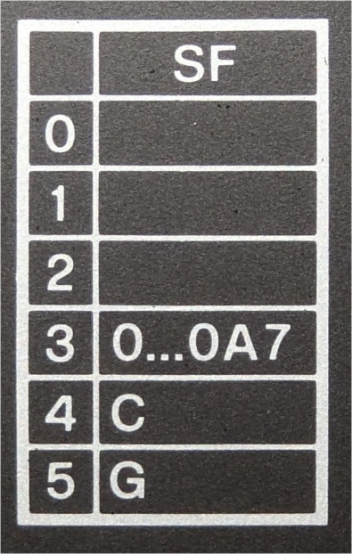
Flag Manipulation
16C:
34S:
Set
Clear
Flip (Invert)

Slide 10
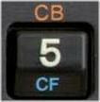
Bit Manipulation
16C:
34S:
Set Bit
Clear Bit
Flip Bit
Bit Set?
Bit Clear?
No. of
Bits

Slide 11
Logical Operations
16C:
34S:
AND
OR
NOT
XOR

Slide 12
Rotate/Shift/Mask Operations
16C:
34S:

Slide 13
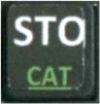
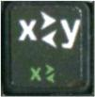
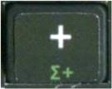
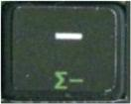
Register Access Operations
16C:
34S:
n
n
n
n
n
n
n
n
n
n
n
n
n
n

Slide 14
A Brief Word About Programming
16C:
34S:
203 (minus data-reg space) No. of Steps 506 (×8 sets)
0 – 9, A – F Prgm Labels 00-99, A – D, 3-char ALPHA
4 levels Subroutines 8 levels
Timing:
Fill stack with 1’s, and enter the program: LBL A, +, GTO A
Press R/S and run for approx. 10 seconds:
16C: 38 counts 34S: 52,089 counts

