Slide 1
Calculator Odds and Ends
Jake Schwartz

Slide 2
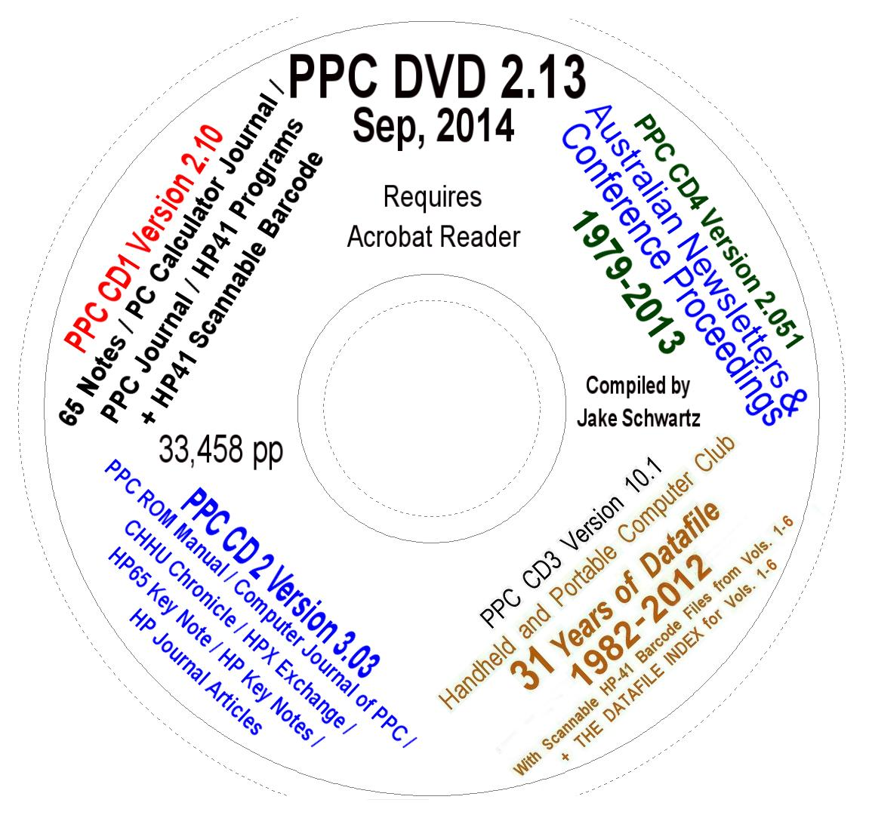
An “Odd”: Updated PPC Archive DVD

Slide 3
Updates
Made to
The HPCC
Datafile
area

Slide 4
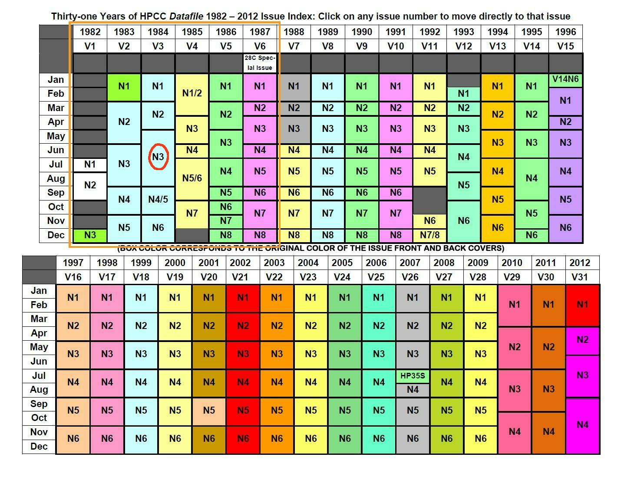
First 6 volumes received the “J.W. treatment”

Slide 5
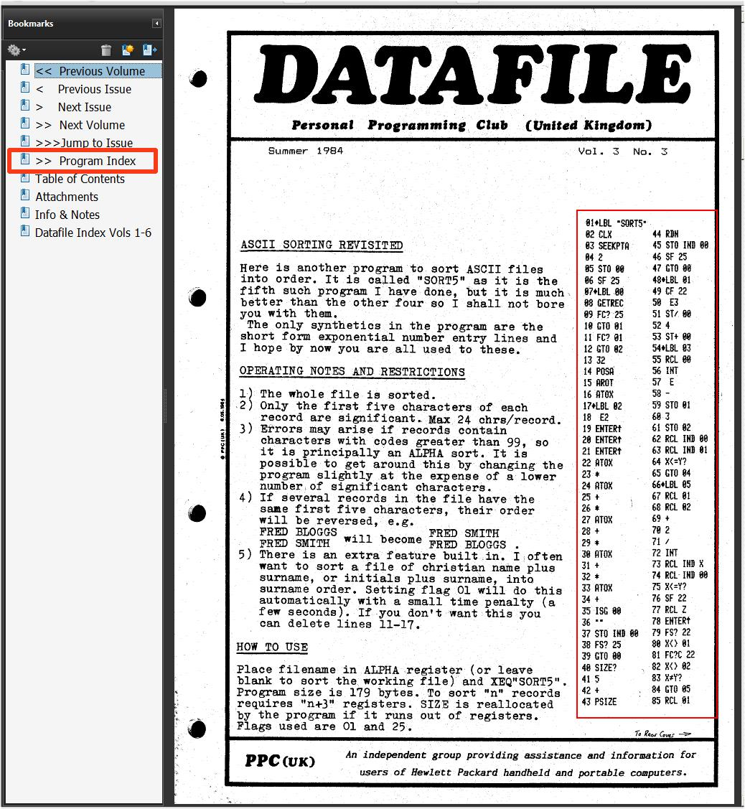

Slide 6
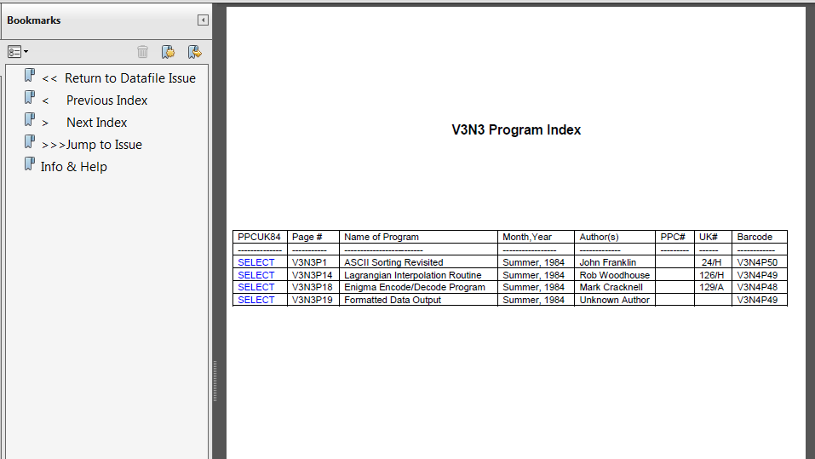
Program index of scannable HP-41 barcode files

Slide 7
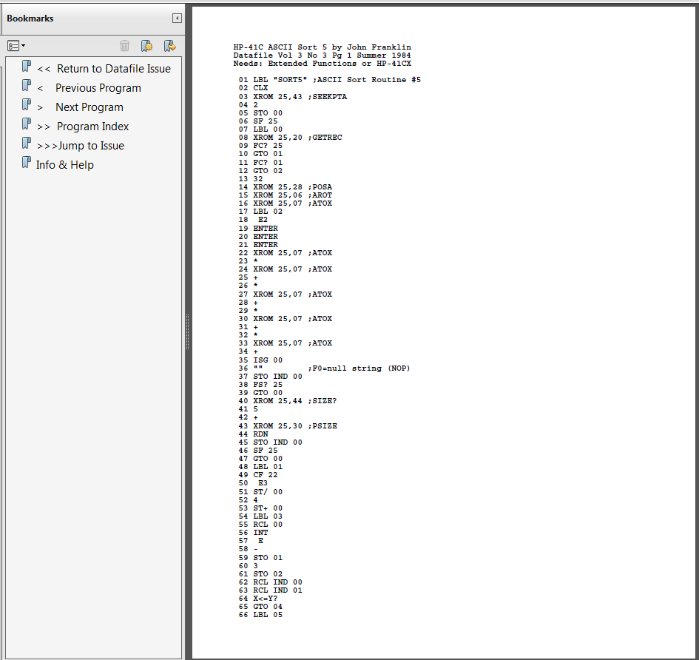
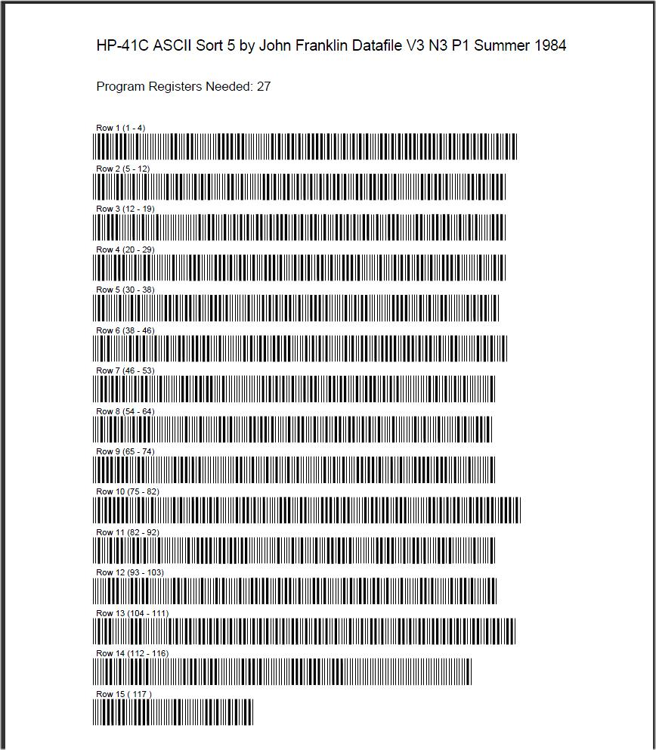

Slide 8
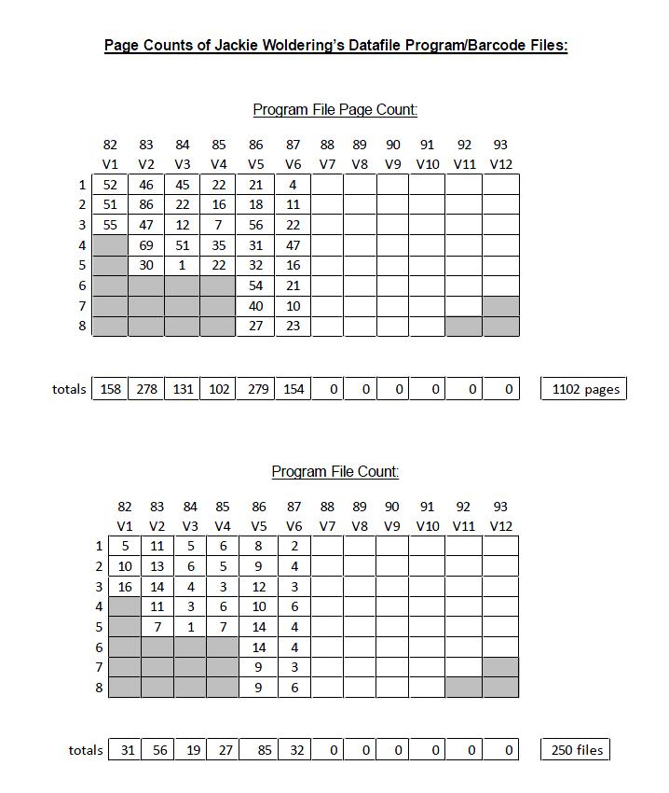

Slide 9
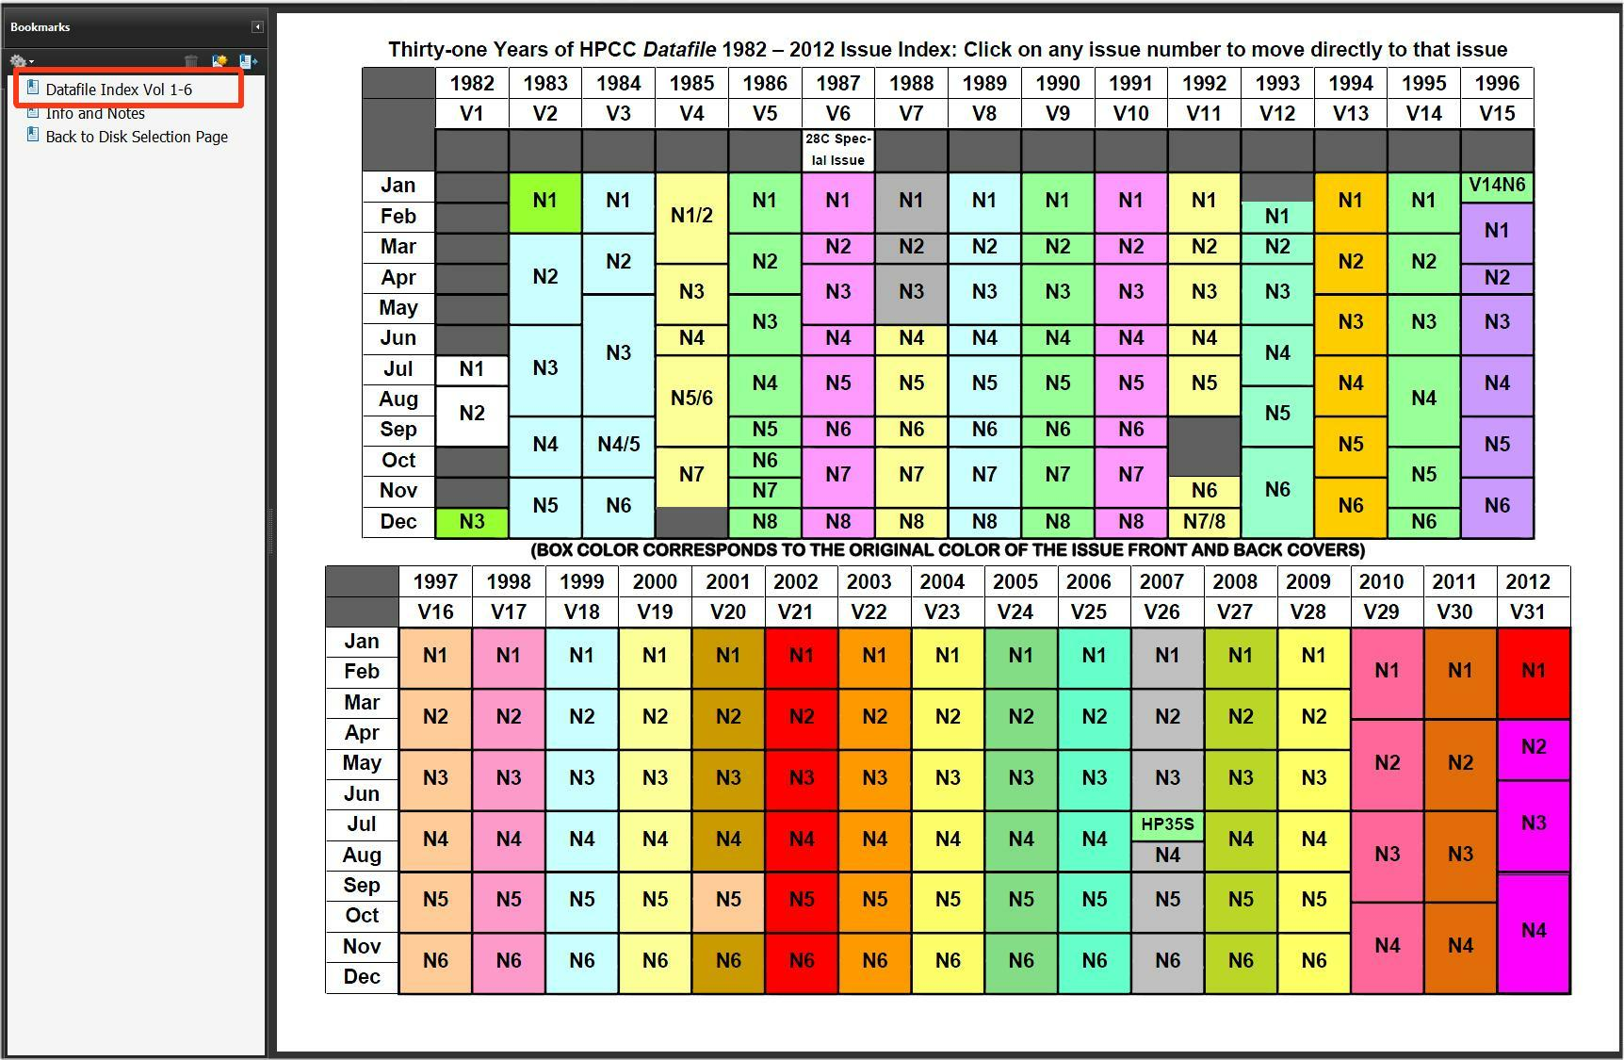
A Datafile comprehensive index started with the same issue coverage

Slide 10
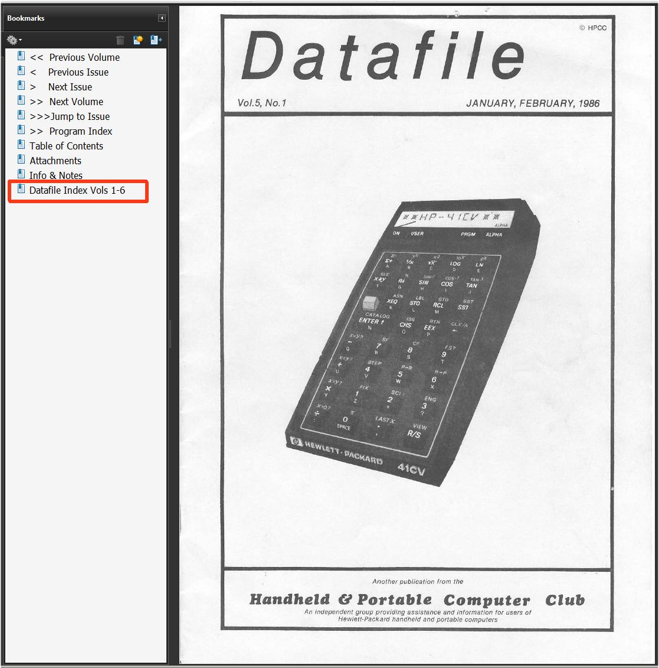

Slide 11
Indexed
5 ways
With 980
Entries
So far

Slide 12
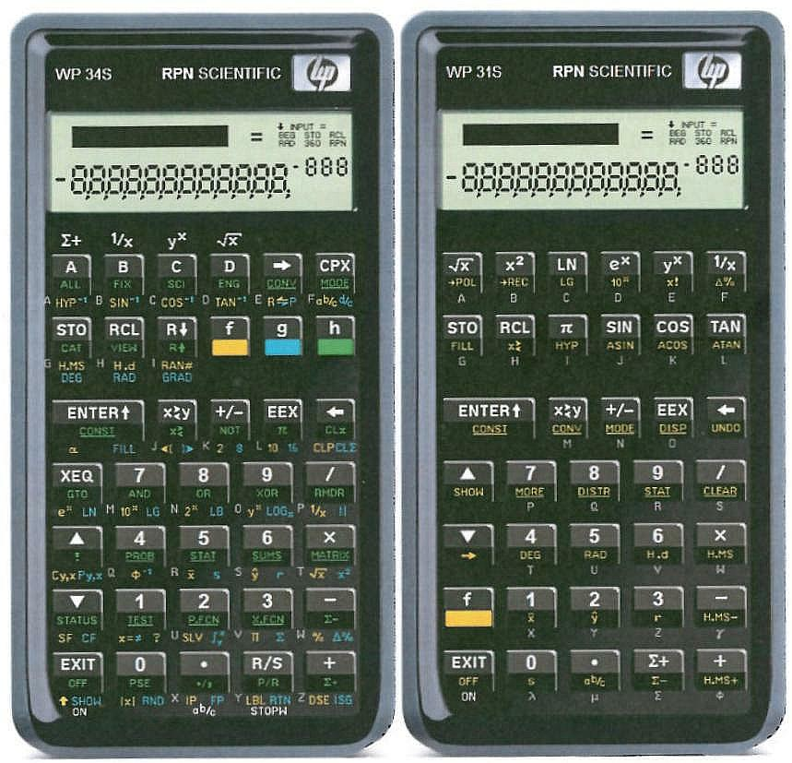
An “End”: The WP 34S and WP 31S
Calculators and Printed Manuals

Slide 13
WP 34S Firmware by Walter Bonin,
Paul Dale and Marcus von Cube
WP 31S Firmware by Sanjeev Visvanatha
And Jonathan Cameron

Slide 14
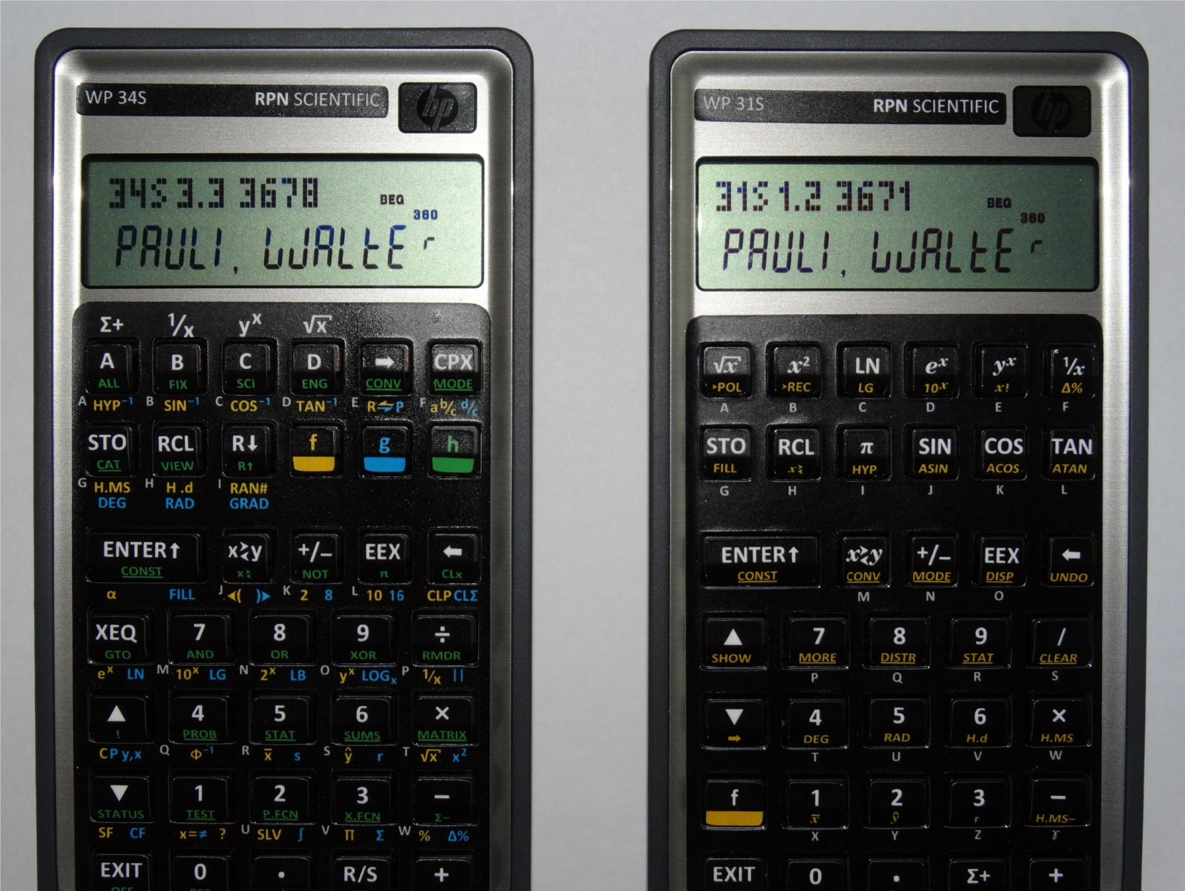
Recent Firmware versions

Slide 15
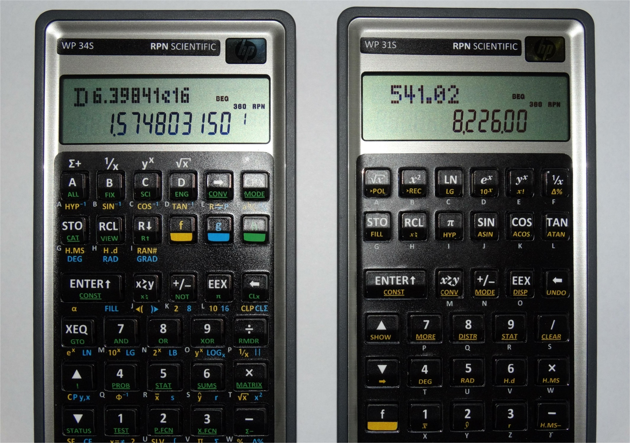
With the recently-added “YDON” Y-register display

Slide 16
Comparison of Major Features
 | WP 34S | WP 31S
Programmable | Y | N
4 or 8-level RPN Stack | Y | Y
Double Precision Mode off/on | Y | N
Y Display On/Off | Y | Y
Memory Registers (global) | 112 | 23
Flags (global) | 112 | N
Full UNDO | only RCL L | Y
Stat/Prob with 14 stat registers | Y | Y
Fraction Mode | Y | Y
Complex Operations | Y | N
Matrix and Vector Math | Y | N
Physical Constants | 50 | >50
Conversions | 80 | >80
Base Arithmetic | Y | N
Special ALPHA Characters | Y | N

Slide 17
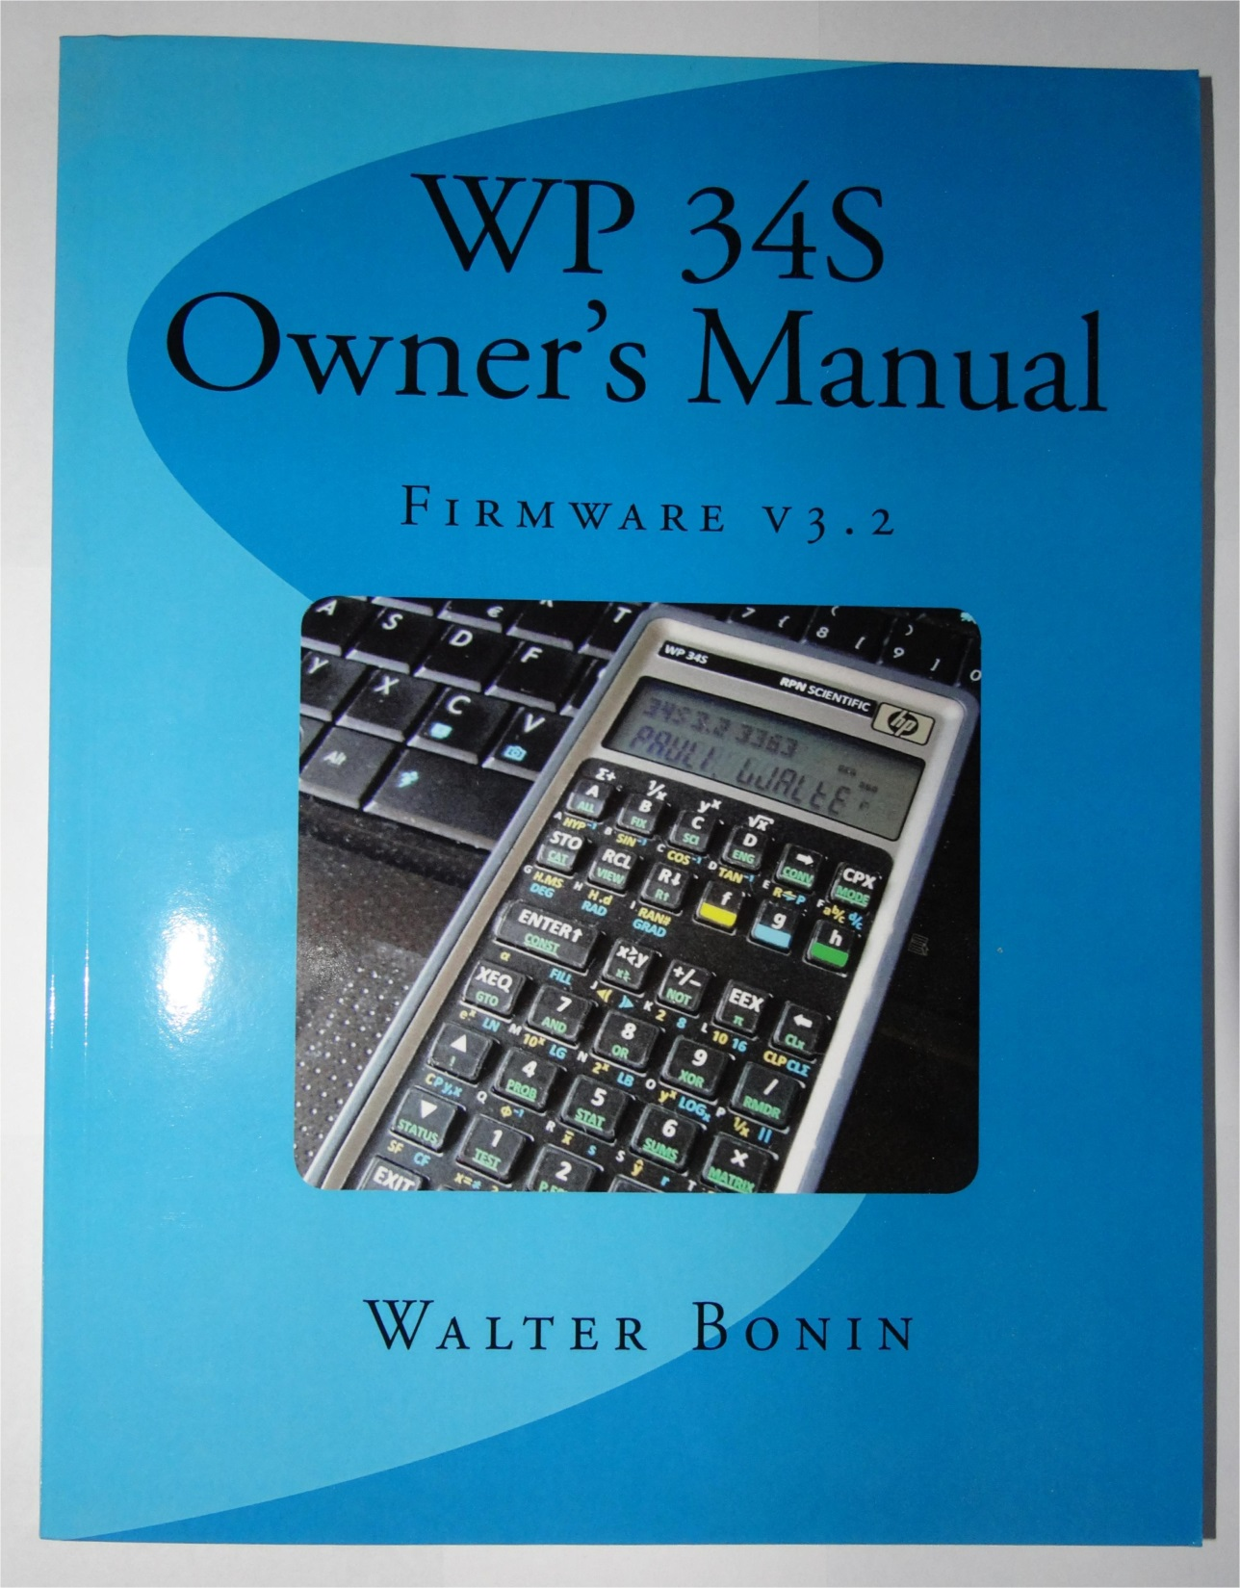
The Original
2012 WP 34S
Printed
Owner’s Manual

Slide 18
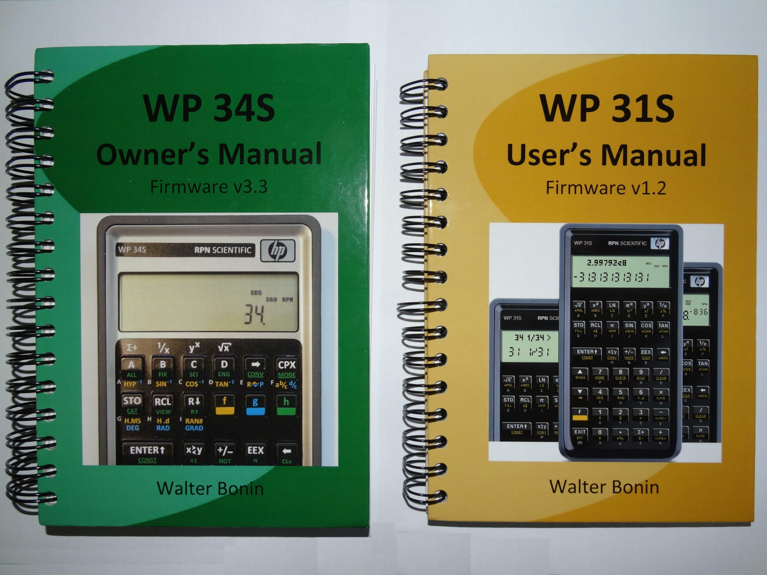
The Printed Manuals
370 pp, ~$51.00 to U.S. 150pp, ~$35.00 to U.S.

Slide 19
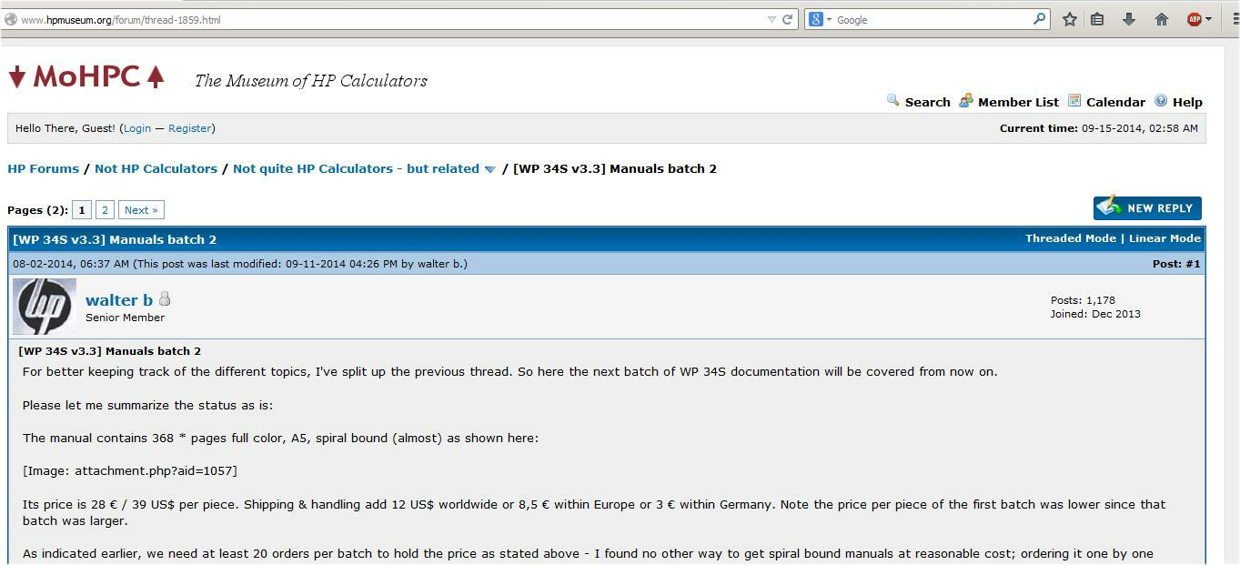
Book orders have been handled via the HP Museum Forum in the
“Not quite HP Calculators – but related” section.
Walter is taking orders for and printing batches of twenty.

Slide 20
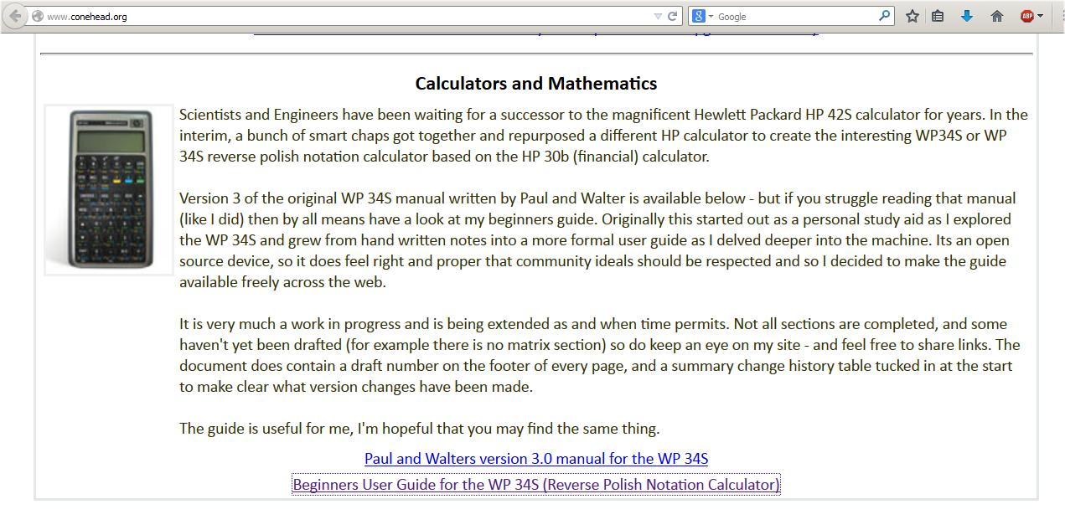
A 34S Beginner’s User Guide (V3.1 firmware)
also is available at www.conehead.org as a free download

Slide 21
Written by
Ciaran J. Brady

Slide 22
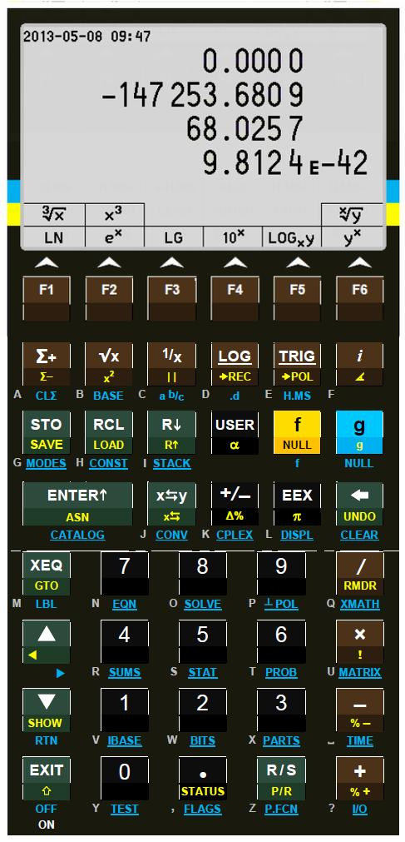
Keep your fingers crossed
for the 43S ☺
Check
http://sourceforge.net/projects/wp43s/?source=directory
For the latest firmware news

